Slide 1

Using ShinyR for Heart Disease Analysis
Devansh Pathak
HDSC 824
12/17/2024
Interactive data exploration, analysis, and prediction tool

Slide 2
Background and Motivation
Introduction to the Problem:
Cardiovascular diseases (CVDs) are the leading cause of mortality globally, responsible for over 17.9 million deaths annually.^{[1]}
Early identification of key predictors of heart disease can significantly improve patient outcomes and guide healthcare interventions.
Dataset
UCI Heart Disease Dataset (Cleveland subset), a publicly available dataset for research. ^{[2]}
Contains 303 observations with 14 clinical demographic features.
Why It’s Interesting:
Interactive tools are essential for exploring clinical patterns and building predictive models to help healthcare professionals.

Slide 3
Objectives
Main Objectives:
Develop Shiny App to enable interactive exploration of heart disease data.
Use data visualization to uncover meaningful insights and patterns.
Build machine learning models to predict presence of heart disease.
Deliverables:
Fully functional Shiny application
Comparison of Logistic Regression and Random Forest Models.
Visualizations demonstrating relationships in the data.

Slide 4
Data Overview
Key Features:
Demographic Features: age, sex
Clinical Measurements: chol (cholesterol), trestbps (resting blood pressure), thalach (max heart rate), oldpeak (ST depression).
Target Variable: Presence of heart disease (0 = no disease, 1 = disease).
Challenges:
Handling missing data (ca, thal)
Ensuring appropriate scaling for machine learning models.

Slide 5
Overview of Data Variable(s) used
Feature | Description | Type
age | Age of the patient | Numeric
sex | Gender (1 = Male, 0 = Female) | Categorical
chol | Serum Cholesterol Level | Numeric
trestbps | Resting Blood pressure | Numeric
target | Heart disease presence | Binary

Slide 6
Methodology
Steps:
Data Preprocessing (handling missing values, log transformations).
Data Visualization (exploring patterns with ggplot2).
Machine Learning Models (Logistic Regression and Random Forest).
Model Evaluation (AUC and ROC Curves).
Tools: R, Shiny, ggplot2, caret, pROC, randomForest.

Slide 7
Shiny Application Overview
What the Application Does:
Data Summary:
Summary statistics and missing values.
Data Exploration:
Interactive histograms, boxplots, and scatter plots.
Model Evaluation:
Logistic Regression and Random Forest models.
ROC curve comparisons and AUC scores.
Key Functionalities:
Users can dynamically select predictors and visualizations.
Compare model performances using AUC metrics.

Slide 8
Data Exploration – Distribution, Boxplot, & Scatterplot Analysis
Visualizing the distribution and boxplot of Age, Cholesterol, Resting BP, and Oldpeak.
Insights:
Age group 45-65 shows a higher prevalence of heart disease.
Patients with heart disease tend to have higher Cholesterol and Resting BP.
Clustering patterns observed for target groups in our Scatterplot charts

Slide 9
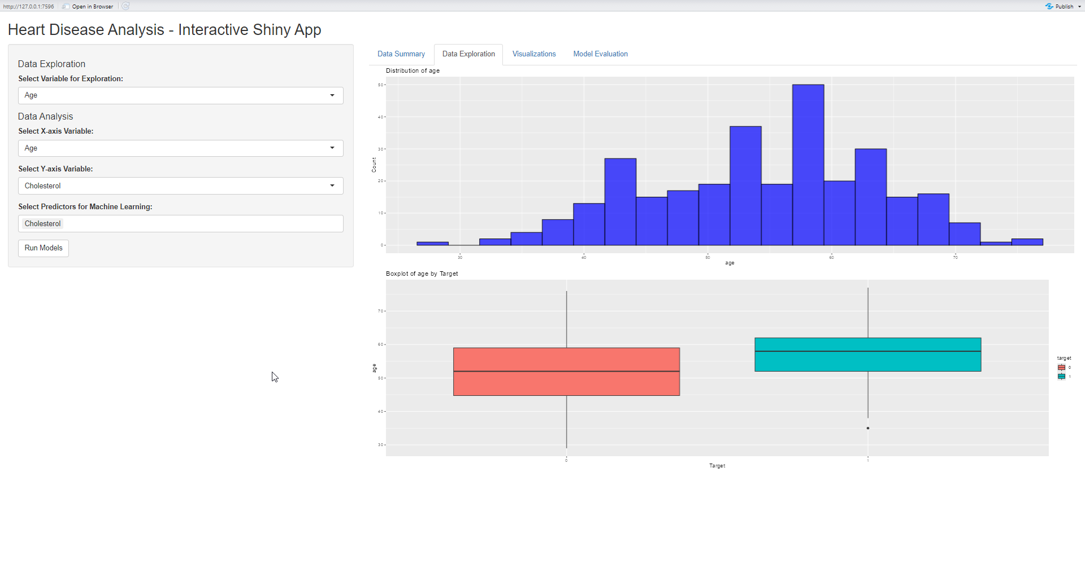
Distribution of Age with Target

Slide 10
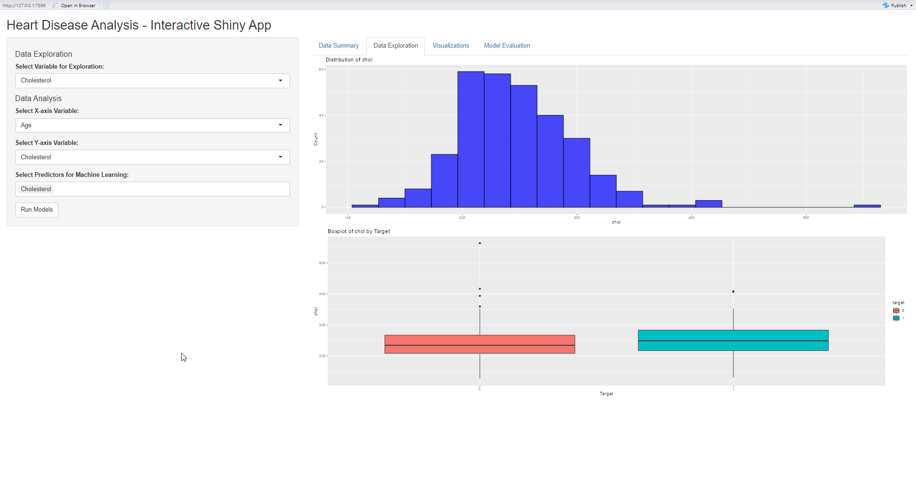
Distribution of Cholesterol with Target

Slide 11
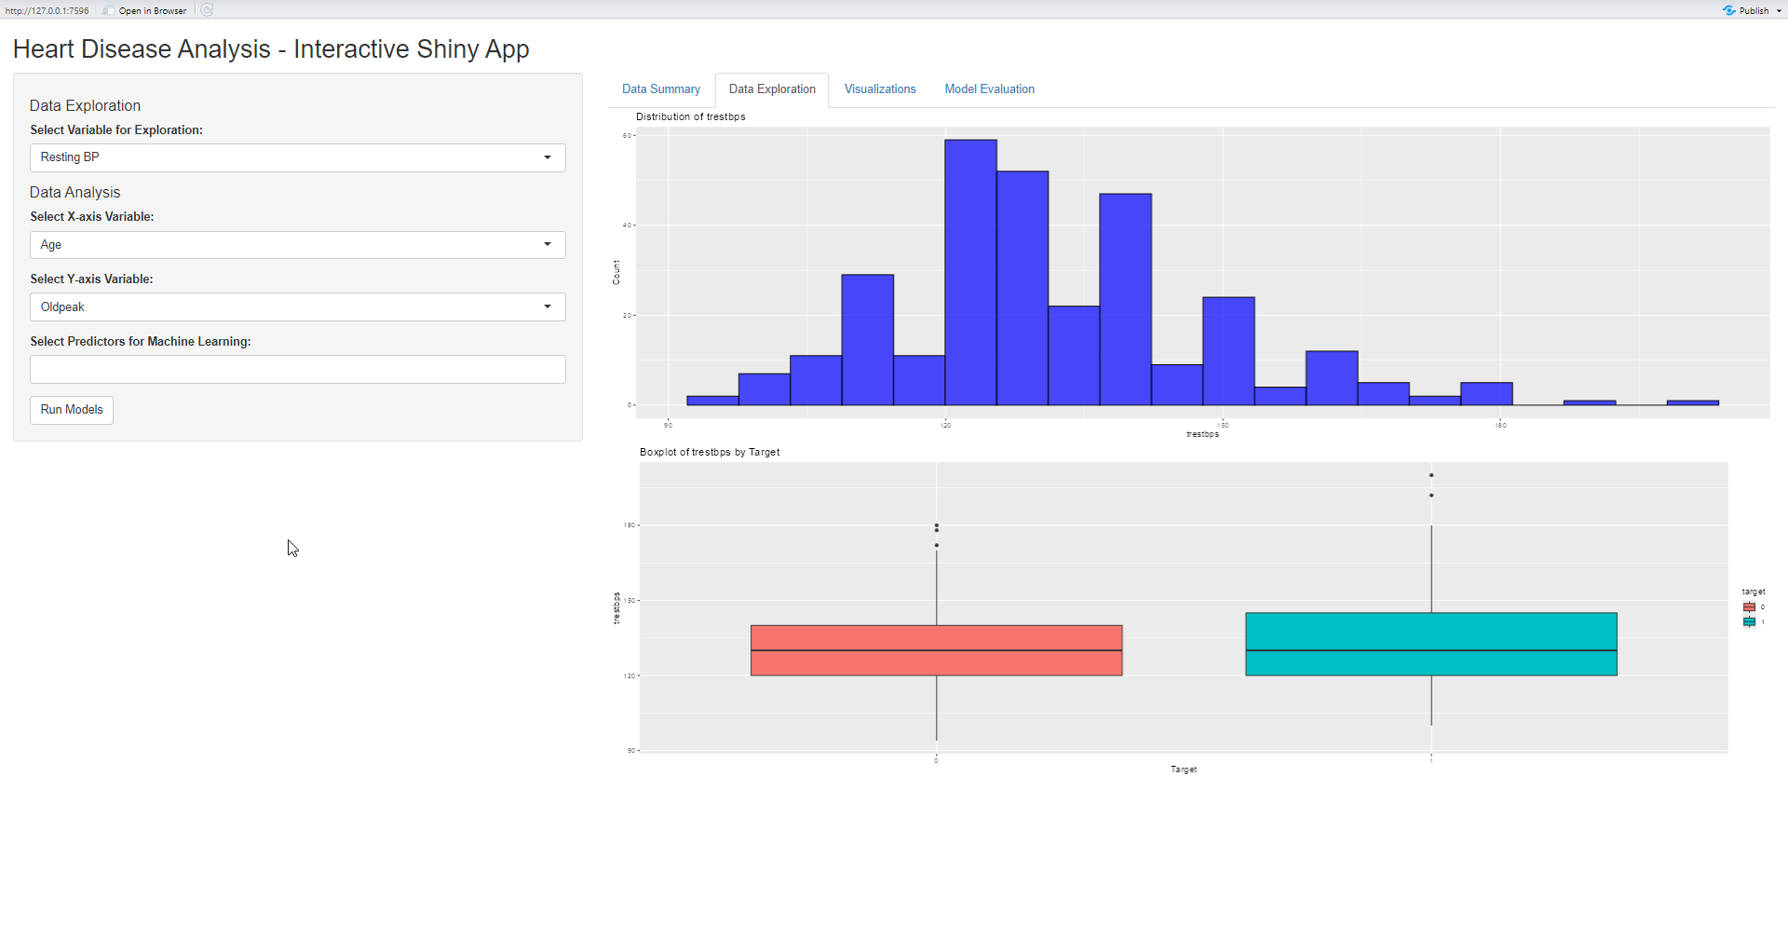
Distribution of Resting BP with Target

Slide 12
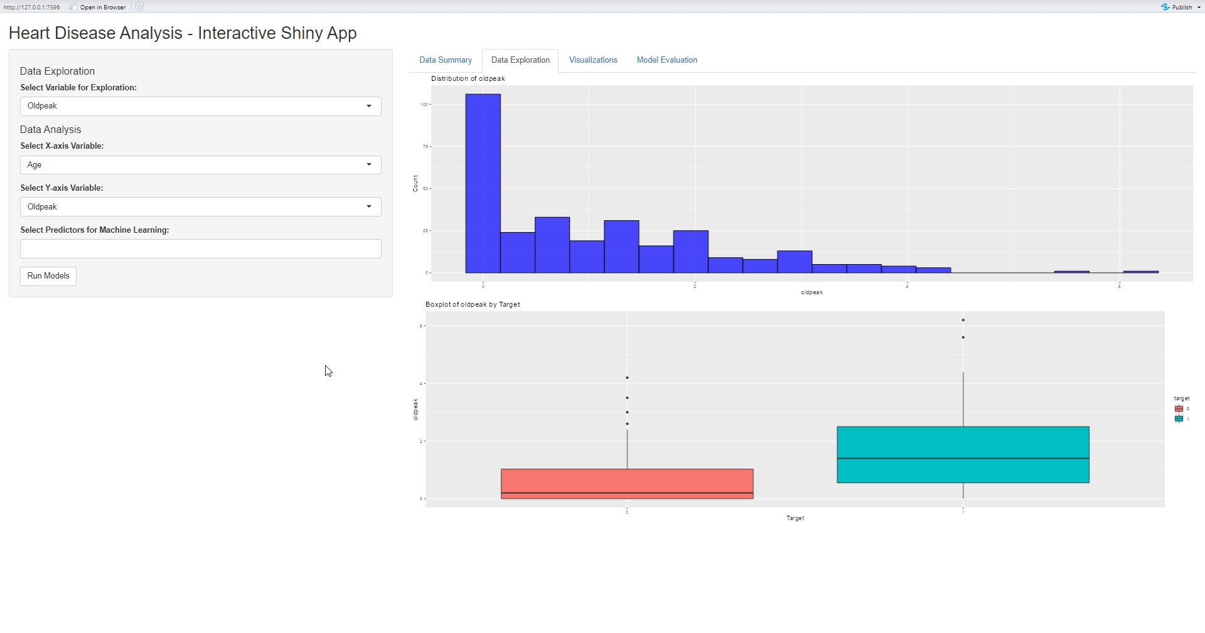
Distribution of oldpeak with Target

Slide 13
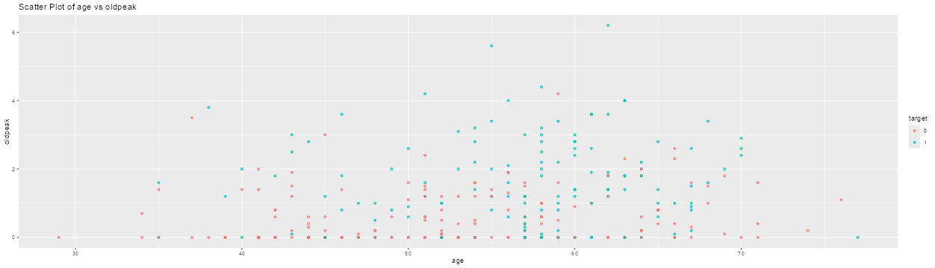
Age vs Oldpeak

Slide 14
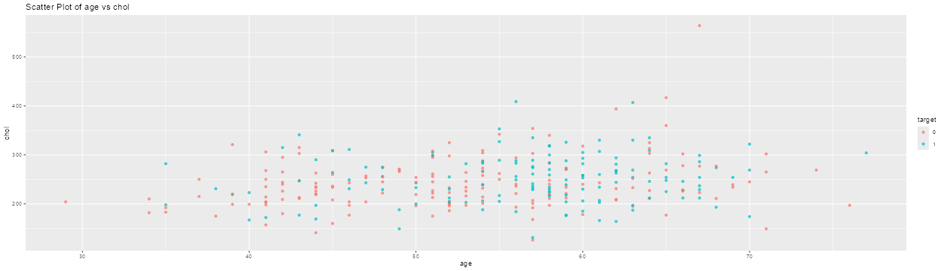
Age vs Cholesterol

Slide 15
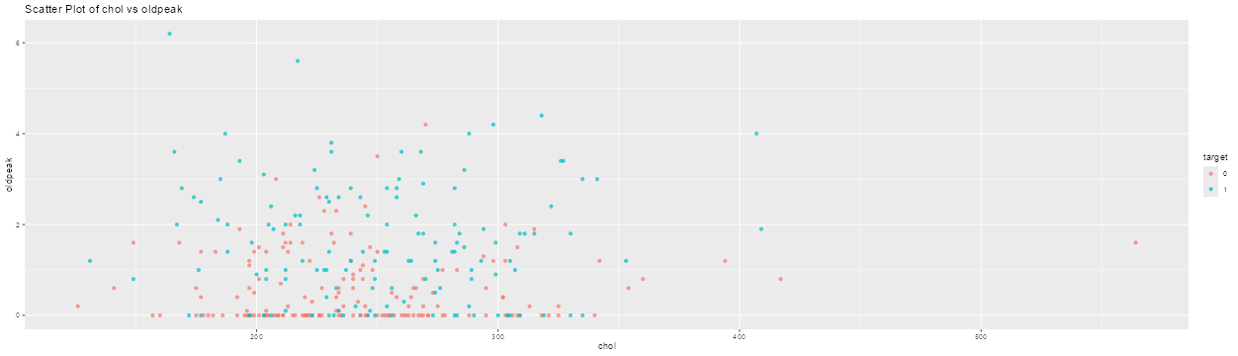
Cholesterol vs oldpeak

Slide 16
Machine Learning Models
Models:
Logistic Regression and Random Forest.
Features:
Age, Sex, Cholesterol, Resting BP, Oldpeak (log-transformed).
Performance metrics:
AUC scores for both models.
Insights:
Logistic Regression slightly outperformed Random Forest on this dataset

Slide 17
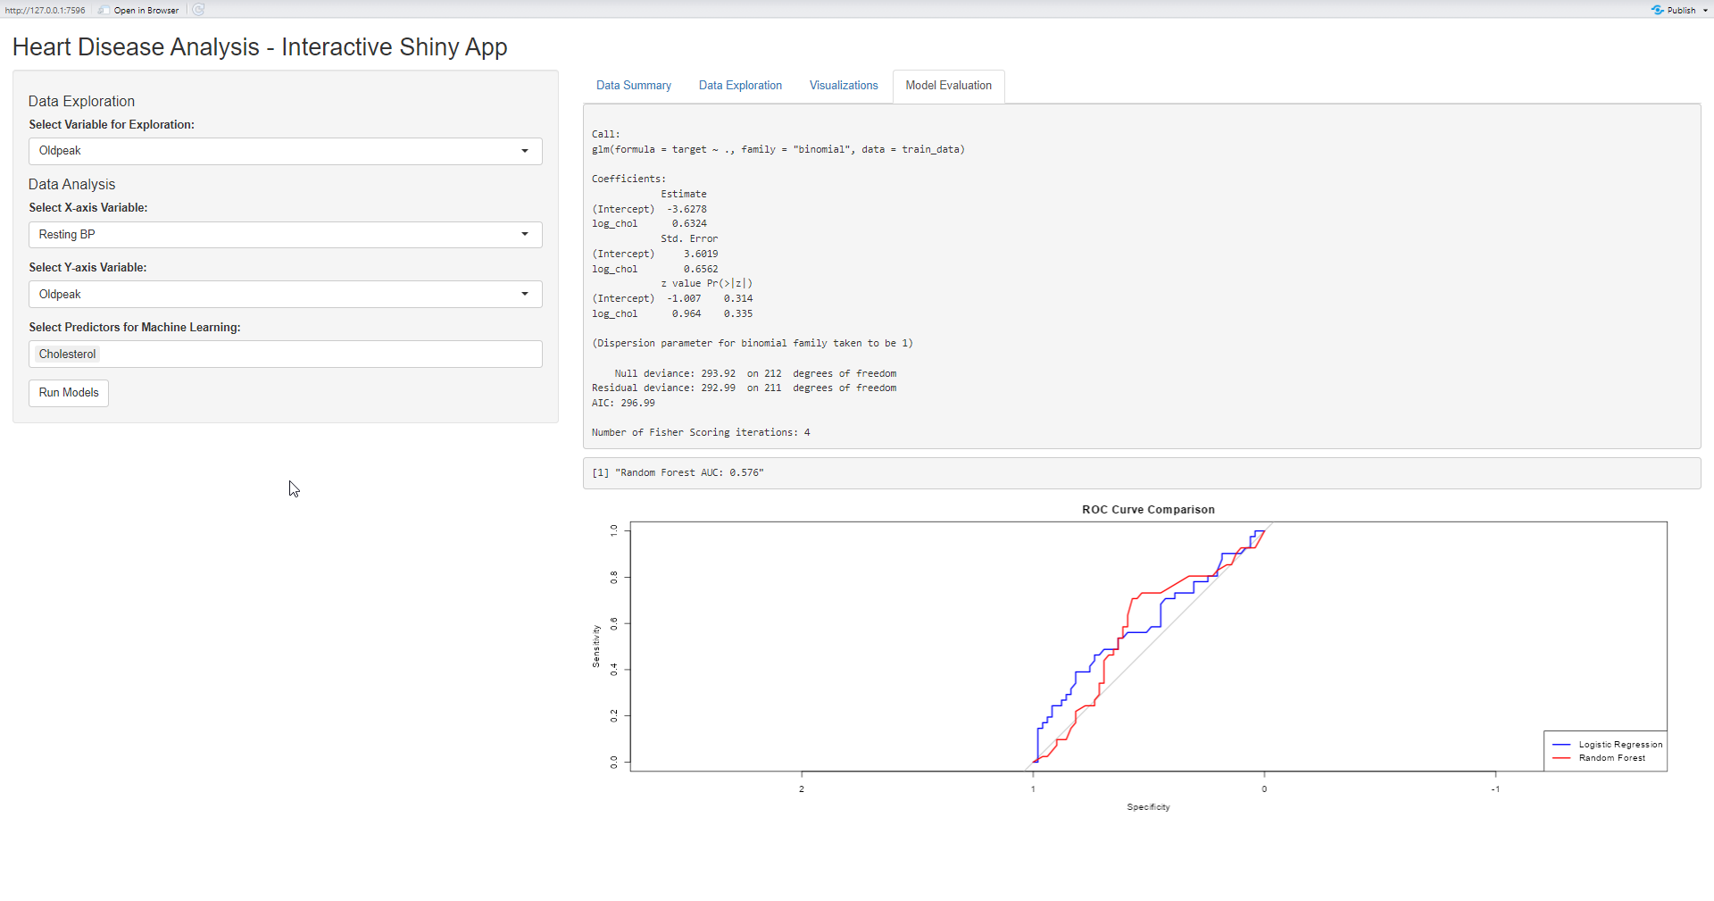
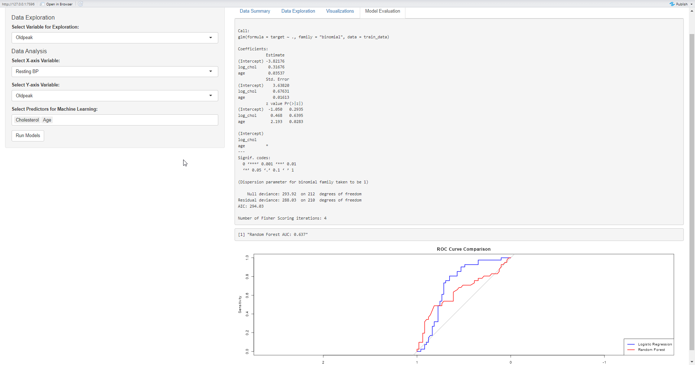
Demo of Model Evaluation

Slide 18
Key Insights & Results
Key Predictors
Age, Cholesterol, Resting BP
Logistic Regression is slightly more reliable than Random Forest for predicting Heart Disease
Visualization provided insights into variable distributions and relationships

Slide 19
Conclusions
This tool is useful for healthcare personnel
Due to small sample size, the need for large dataset is needed to refine the models and develop more complex models. This in-turn can be used for real-time deployment.

Slide 20
References
^{[1]} https://www.who.int/health-topics/cardiovascular-diseases#tab=tab_1
^{[2]} https://archive.ics.uci.edu/dataset/45/heart+disease

